Slide 1
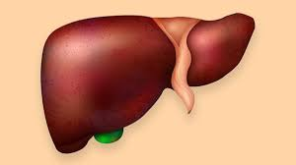
Interpretation of Liver Function Tests
(LFTs)
H.MOGHAVEMI M.D
Obstetrician&Gyneco0logist

Slide 2
Introduction
Alanine amino transaminase (ALT)
Aspartate aminotransferase (AST)
Gamma-glutamyl transferase (GGT)
Alkaline phosphatase (ALP)
Bilirubin
Albumin
INR
Fibrinogen—prothrombin

Slide 3
AlT

Slide 4
What is the function of the AST?
AST =SGOT

Slide 6
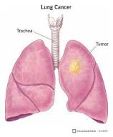
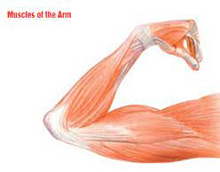
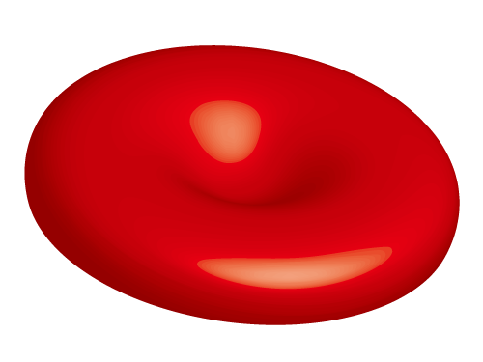
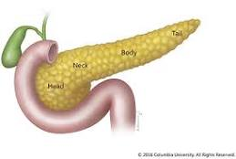
AST
AST
AST
AST

Slide 7
The AST/ALT ratio
Or
De Ritis ratio is the ratio between the concentrations of two enzymes

Slide 8
>2 Advanced hepatic fibrosis

Slide 9
Clinical parameters | SGPT (ALT) | SGOT (AST)
Normal range | 5 to 35 IU/L | 10 to 40 IU/L
Half-life in blood | 35 to 57 hours (3 to 5 days) | 12 to 22 hours
Change with acute inflammatory conditions | It is moderately sensitive | It is extremely sensitive
The rise in metastatic or primary neoplasm | It is moderate or no change | It is markedly increased
In cirrhosis | It is a mild to moderate increase | It moderately increase
In acute myocardial infarction | It is a mild to moderate increase | It markedly increase
ALT (SGPT) is more raised than( AST) in acute hepatobiliary obstruction than AST (SGOT).

Slide 10
Why is AST higher than ALT in alcoholic patient ?
B6 depletion
Mitochondrial damage
(ALT inactive)
Alcohol

Slide 11
Serum alkaline phosphatase (ALP)
and
Billirubin

Slide 12
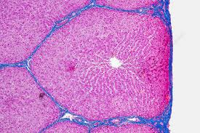

Slide 17
95% water

Slide 18
K

Slide 19
Uridine Diphosphate Glucuronic Acid -
Uridine Glucuronic Transferase

Slide 21
More severe than Gilbert

Slide 22
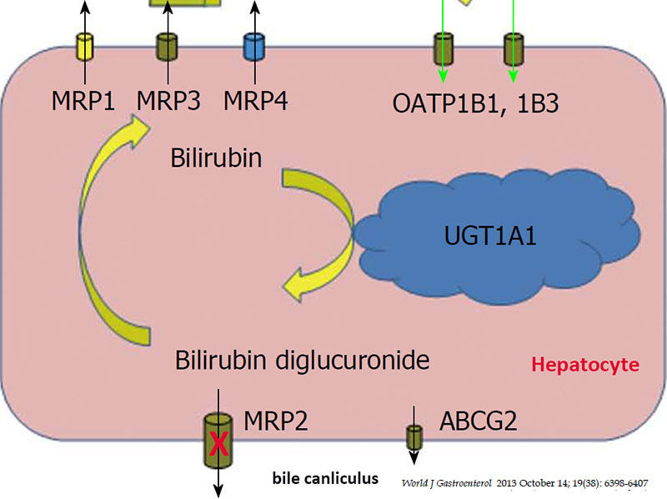
Dubin jonson
(Dark Liver)

Slide 23
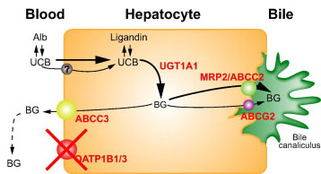
Rotor Syndrome
Impaired hepatocellular storage of conjugated bilirubin that leaks into plasma,

Slide 24
GGT 0—30 IU/L

Slide 25
Gamma-Glutamyl Transferase
(GGT)

Slide 26
An isolated GGT rise is classically associated with alcohol excess ALP rise without GGT rise suggest Bony pathology.

Slide 27
The pattern of ALT to ALP rise
ALT> 10 times and ALP < 3 suggest Hepatocellular injury
ALT< 10 times and ALP>3 suggests Cholestasis
Mixed picture suggest Hepatocellular injury and Cholestasis

Slide 28
All coagulation factor
Except
Von Willebrand factor
Tissue plasminogen activator
Endothelial cells and bone marrow cells
Neurons, glial cells, and endothelial cells

Slide 30
Albumin

Slide 32
LFT in pregnancy
It is important to note that the upper limit of transaminases, GGT and bilirubin in pregnancy is 20% lower than the non-pregnant range.

Slide 34
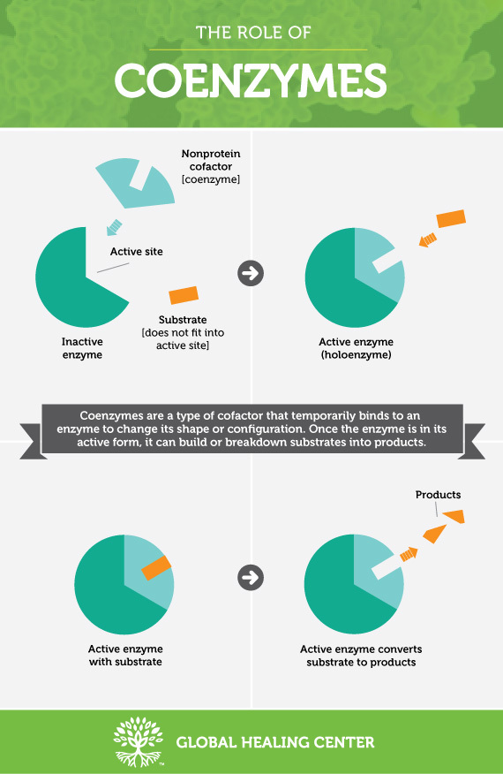
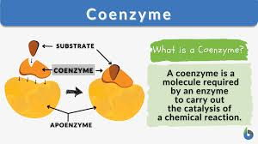

Slide 37
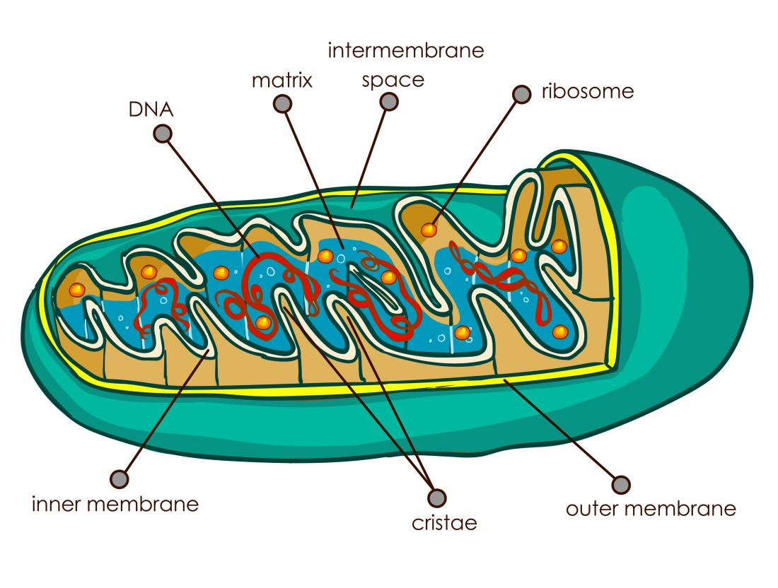

Slide 38
Long-chain 3-hydroxyacyl-CoA dehydrogenase (LCHAD)

